Slide 1

Language Models are Unsupervised Multitask Learners
Presented by: Adam Zelzer, Nitzan Ron
Notes:
Adam+Nitzan

Slide 2
Introduction
Notes:
Adam

Slide 3

About the Paper
A paper by employees and founders: Alec Radford, Jeffrey Wu, Rewon Child, David Luan, Dario Amodei and Ilya Sutskever.
Published in 2019.
Describes GPT-II, the second generation of GPT models.
Notes:
Adam

Slide 4
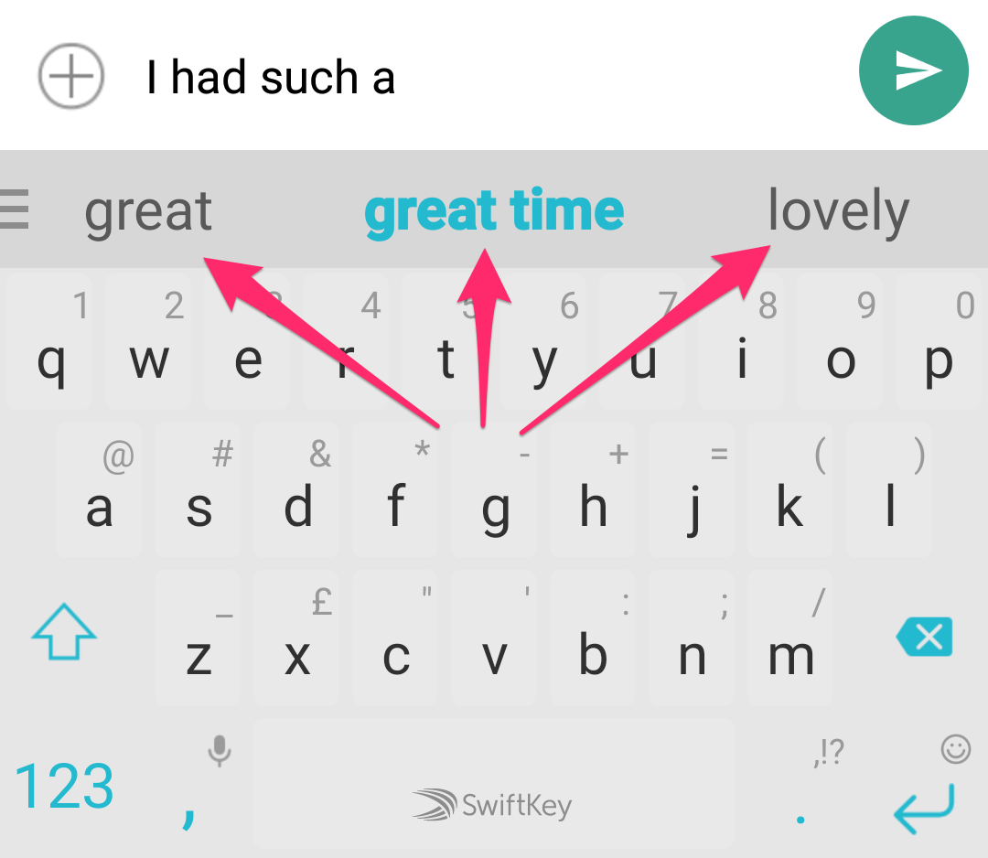
What is a Language Model?
A language model is a machine learning model that is able to predict the next word in a sentence based on its previous content.
Notes:
Adam

Slide 5
Prior Work
Notes:
Nitzan

Slide 6
Previous Models
The field of NLP was relatively new at the time. There were a couple of different attempts and approaches to language modeling:
ELMo (University of Washington, 2018)
BERT (Google, 2018)
MQAN (Salesforce, 2018)
GPT-I (OpenAI, 2018)
Notes:
Nitzan

Slide 7
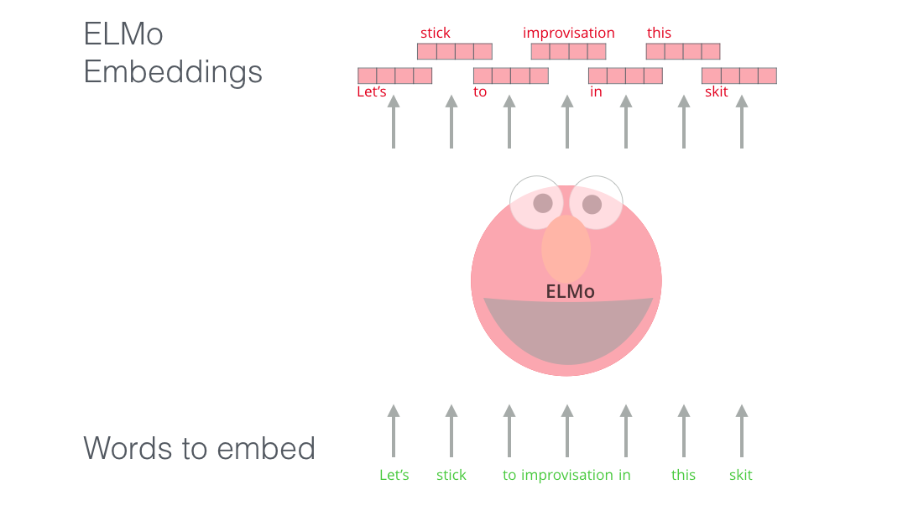
ELMo
Embeddings from Language Model.
Based on an LSTM architecture.
Provides context sensitive word embeddings.
Fine-tuned for specific tasks.
Notes:
Nitzan

Slide 8
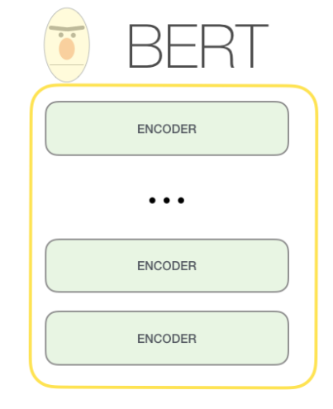

BERT
Bidirectional Encoder Representations from Transformer.
Trained in a semi-supervised setting.
Can be Fine-tuned for specific tasks, such as QA.
Notes:
Nitzan

Slide 9
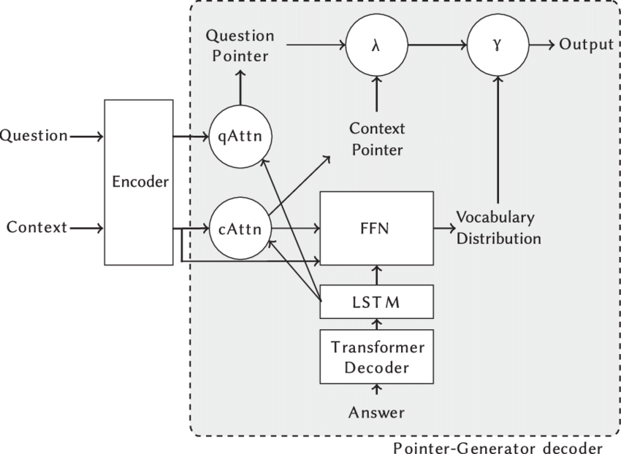
MQAN
Multi-task Question Answering Network.
Utilizes both LSTMs and transformers.
Multitask learner.
Typically fine-tuned for specific tasks (QA).
Notes:
McCann (2018) demonstrated it was possible to train the MQAN to infer and perform many different tasks on examples with (tasks, input, output) type of format. Like:
(translate to french, english text, french text).
Nitzan

Slide 10
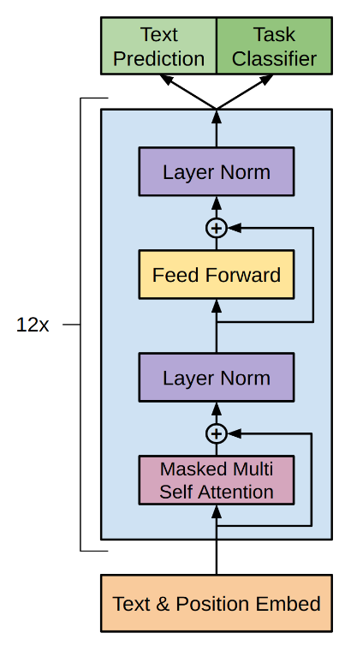
GPT-I
Generative Pre-trained Transformer.
Predecessor to GPT-II.
Trained in an unsupervised setting.
General purpose model, able to generate coherent text.
Notes:
Nitzan

Slide 11



Main Idea - MORE!
Notes:
Nitzan

Slide 12
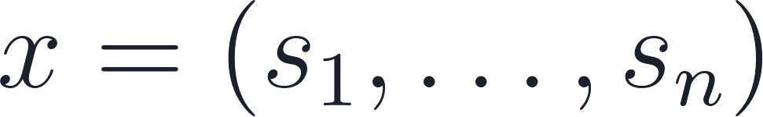
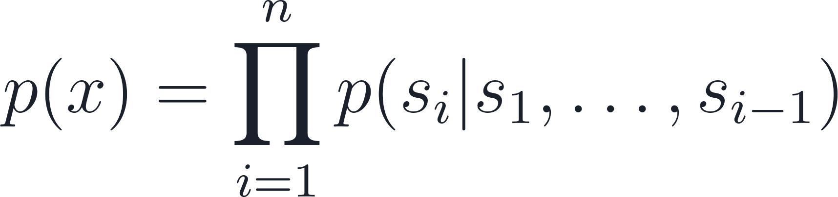
Language Modeling
Language is structured in a sequential ordering.
Given a sequence of symbols , the model estimates the distribution:
Notes:
Nitzan

Slide 13

Multitask Learning
Instead of learning: p(output|input) We can learn: p(output|input, task)
This can be done easily with language modeling, using training examples of the form:
(task, input, output)
For example:
(translate from English to French, Hello!, Bonjour!)
Notes:
Nitzan

Slide 14
Required Dataset
To achieve multitask learning, a dataset whose objects contain task descriptions, text inputs and labels would be needed. There is no such dataset, and creating one is an immense job.
Notes:
Nitzan

Slide 15
Solution - Unsupervised Learning
The researchers conjectured that an unlabeled, yet large, high quality, and diverse dataset would include enough language demonstration tasks in different domains that would help the model learn them.
This conjecture resulted in the creation of the WebText database.
Notes:
Nitzan

Slide 16



Training Data - Prior Work
Most prior work trained language models on a single domain of text.
Book Corpus
(800M words)
Wikipedia
(2500M words)
BERT Training Data
Notes:
Nitzan

Slide 17


Common Crawl
Dataset containing web-page text, scraped from billions of pages.
Large
Diverse
High-quality
Notes:
Nitzan

Slide 18

WebText
Dataset containing Reddit pages whose Karma rating is 3 and above.
Large
Diverse
High-quality
Notes:
Nitzan

Slide 19

Resulting Dataset
Resulting dataset statistics (after deduplication):
45M links
8M documents
40GB of text
(Gorid of all links from Wikipedia).
Notes:
Nitzan

Slide 20
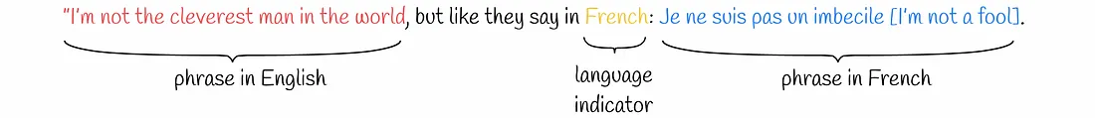
Naturally Occurring Tasks
Example of naturally occurring demonstrations of different tasks found throughout the WebText training set:
Notes:
Nitzan

Slide 21
Model and details
Notes:
Adam

Slide 22

Model
Like GPT-I, GPT-II uses a Transformer based model, which consists of the following:
Word embedding
Positional encoding
Masked attention
Feed-forward network
Softmax
Notes:
Adam

Slide 23
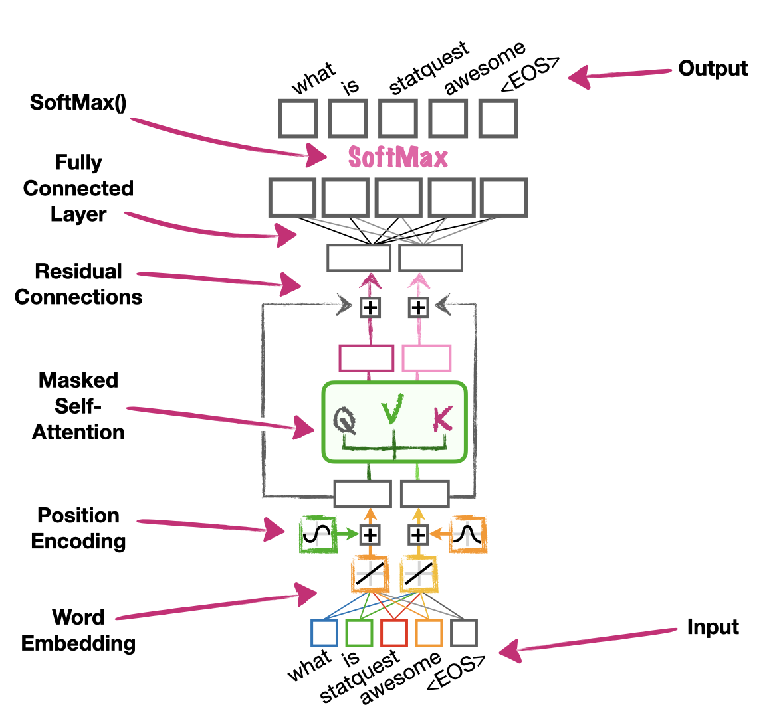
Embed words as vectors in a high-dimensional space, in a way that preserves meaning.
Notes:
Adam

Slide 24
Encode position in sentence by adding sine waves at different frequencies and phases.
Notes:
Adam

Slide 25
Apply self-attention to word vectors, masking future words, to attain contextual meaning.
Notes:
Adam

Slide 26
Add the attention vectors to positionally encoded vectors, to achieve the final word representation.
Notes:
Adam

Slide 27
Pass through a fully connected network, to achieve a final predicted probability distribution.
Notes:
Adam

Slide 28
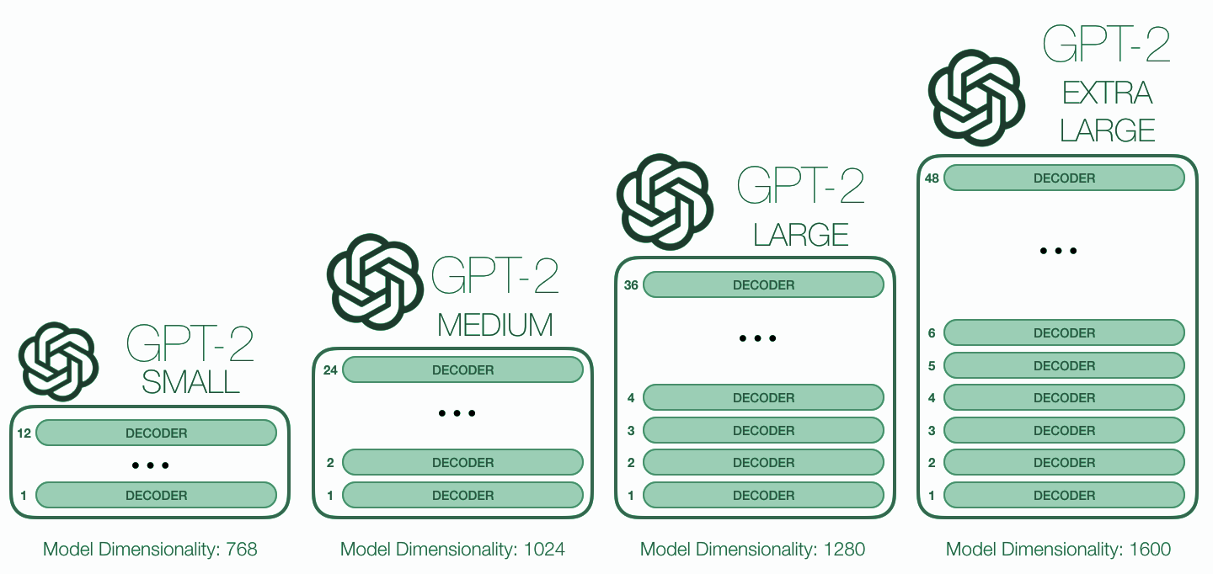
GPT-II - Model Sizes
Notes:
Adam

Slide 29
Compared to GPT-I
GPT-I is equivalent to the smallest size of GPT-II in terms of architecture, with the exception of the following:
Layer normalization was moved to the input of each Transformer block.
Context size was increased from 512 to 768.
Batch size was augmented from 64 to 512.
Vocabulary size was expanded from 40,000 tokens to 50,257.
Notes:
Adam

Slide 30
Results
Notes:
Adam

Slide 31
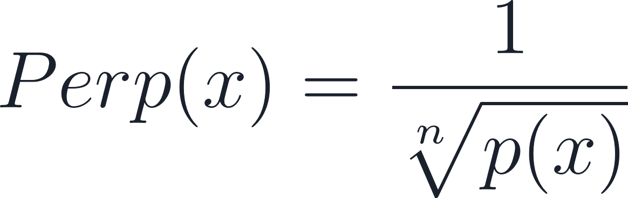
Perplexity
Perplexity measures a language model's uncertainty in predicting the next word, with lower values indicating better performance, the model predicts the data well.
Notes:
Adam

Slide 32
Zero-Shot Results
 | LAMBADA (PPL) | LAMBADA (ACC) | CBT-CN (ACC) | WikiTex-t2 (PPL) | PTB (PPL) | 1BW (PPL)
SOTA | 99.8 | 59.23 | 85.7 | 39.14 | 46.54 | 21.8
117M | 35.13 | 45.99 | 87.65 | 29.41 | 65.85 | 75.20
345M | 15.60 | 55.48 | 92.35 | 22.76 | 47.33 | 55.72
762M | 10.87 | 60.12 | 93.45 | 19.93 | 40.31 | 44.575
1542M | 8.63 | 63.24 | 93.30 | 18.34 | 35.76 | 42.16
Notes:
Adam

Slide 33
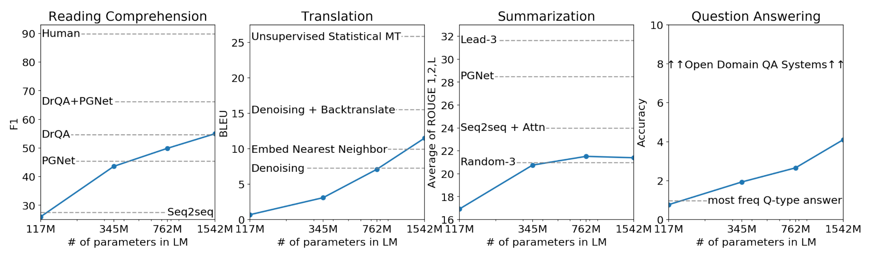
Zero-Shot Results
Notes:
Adam

Slide 34
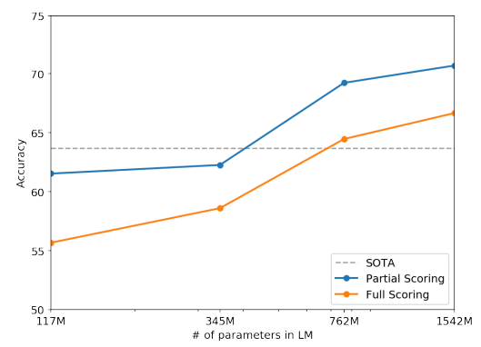
Winograd Schema Challenge
“The trophy doesn’t fit into the brown suitcase because it is too large.”
“The trophy doesn’t fit into the brown suitcase because it is too small.”
In both cases, the model succeeded.
Notes:
Commonsense reasoning by measuring its ability to resolve ambiguities in text.
Nitzan

Slide 35
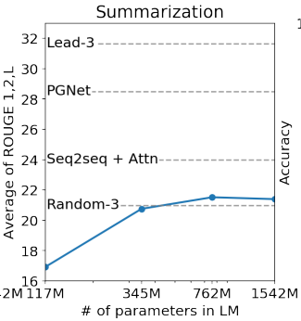
Summarization
Added text TL; DR: after the article and generated 100 tokens with Top 2 random sampling.
Utilized CNN and Daily Mail datasets.
Used 3 generated sentences from these 100 tokens to create the summary.
Notes:
Commonsense reasoning by measuring its ability to resolve ambiguities in text.
Nitzan

Slide 36
Generalization vs. Memorization
It is important to analyze how much test data also shows up in the training data to assess the generalization error accurately.
 | PTB | WikiText-2 | enwik8 | text8 | WikiText-103 | 1BW
Dataset train | 2.67% | 0.66% | 7.50% | 2.34% | 9.09% | 13.19%
WebText train | 0.88% | 1.63% | 6.31% | 3.94% | 2.42% | 3.75%
Notes:
Adam

Slide 37
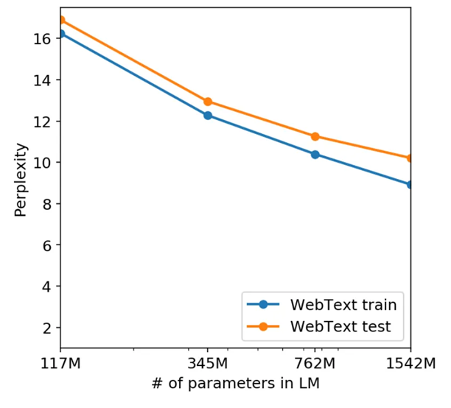
WebText Underfitting
Notes:
Adam

Slide 38
What’s next?
Notes:
Adam

Slide 39
Practical Performance
While the model is qualitatively performing the tasks, its performance is still only rudimentary according to quantitative metrics. In terms of practical applications, the zero-shot performance of GPT-II is still far from usable, and often no better than random for many tasks.
In addition, many other practical tasks remain to be evaluated.
Notes:
Adam

Slide 40
Fine-tuning
The work done so far did not include fine-tuning for specific tasks and purposes. Thus, the potential with fine-tuning remains unclear.
The researchers plan to explore fine-tuning on different benchmarks in order to improve results.
Notes:
Nitzan

Slide 41
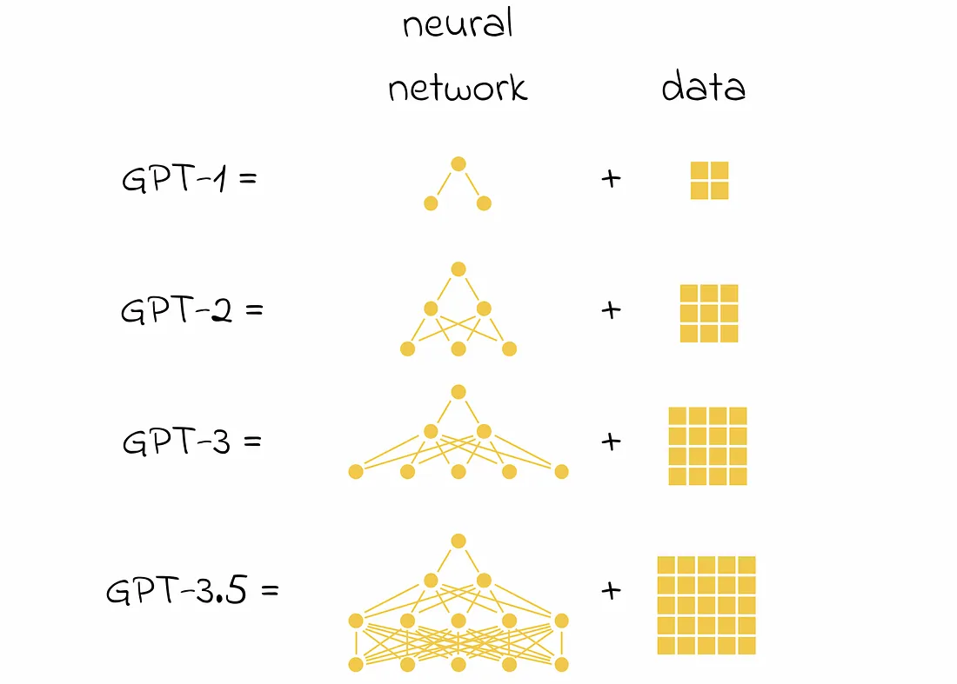
Our thoughts
More parameters seem to improve the model substantially, so it is natural to try increasing model size.
Notes:
Nitzan+Adam

Slide 42
Conclusions
Notes:
Nitzan

Slide 43
Summary and Conclusions
A LLM trained on a sufficiently large and diverse dataset is able to perform well across many domains.
GPT-II demonstrates SOTA performance on 7 out of 8 tested language modeling datasets.
Maximizing the likelihood of a sufficiently varied text corpus allows a model to learn how to perform many tasks without the need for explicit supervision.
Notes:
Nitzan+Adam

Slide 44
A thought-provoking question
OpenAI didn’t release the code for the GPT-II model.
Why do you think that is?
Do you agree with their choice?
Notes:
Adam+Nitzan

